Slide 1

CAPSTONE PROJECT
AVL Trees
for Fast Searching
Presented by
Yericharla Spurthi
Roll.No:CH.EN.U4CCE25037
B.Tech CCE – 2nd Year
Amrita Vishwa Vidyapeetham

Slide 2




The Problem
Binary Search Trees can provide fast searching when they remain balanced. However, the shape of a BST depends on the order in which data is inserted. In an unfavorable insertion order, the tree can become skewed and behave like a linked list. As a result, searching can degrade from O(log n) to O(n). This creates the need for a self-balancing search structure.
  Worst Case: O(n)
  Worst Case: O(n)

Slide 3


Why Do We Need AVL Trees?
The Problem
Unbalanced BST
When data is inserted in an unfavorable order, a BST can become skewed. Its height increases, making the tree behave like a linked list and causing search performance to degrade to O(n).
The Need
We need a search structure that can maintain its balance automatically as data changes. AVL trees solve this problem by monitoring the balance of each node and using rotations to restore balance when necessary.

Slide 4



What Is an AVL Tree?
Self-Balancing BST
An AVL tree is a self-balancing Binary Search Tree (BST). It automatically maintains its height by checking the balance of each node. If the tree becomes unbalanced after an insertion or deletion, rotations are used to restore balance.

Slide 5

Balance Factor
The Key to AVL Balance
  The balance factor of a node is calculated as the height of its left subtree minus the height of its right subtree.
  Balance Factor = Height(Left) − Height(Right)
  In an AVL tree, every node must have a balance factor of −1, 0, or +1.

Slide 6
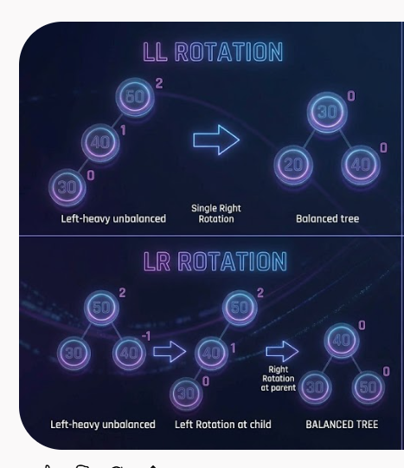
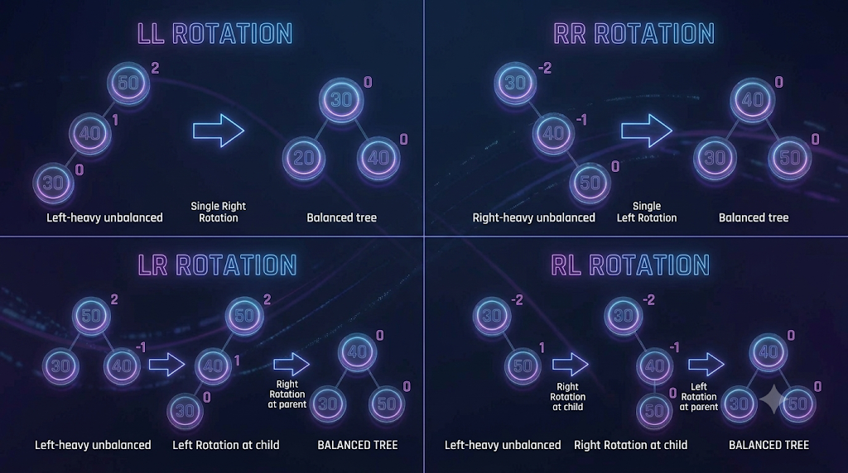
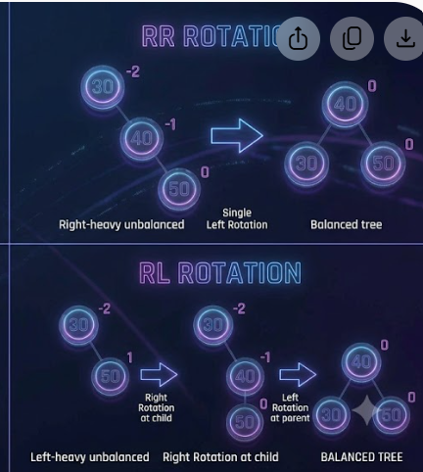
AVL Rotations
LL Rotation
RR Rotation
LR Rotation
RL Rotation
Occurs when a node is inserted into the left subtree of its left child. A single right rotation restores balance.
Occurs when a node is inserted into the right subtree of its right child. A single left rotation restores balance.
Occurs when a node is inserted into the right subtree of its left child. It requires a left rotation followed by a right rotation.
Occurs when a node is inserted into the left subtree of its right child. It requires a right rotation followed by a left rotation.

Slide 7
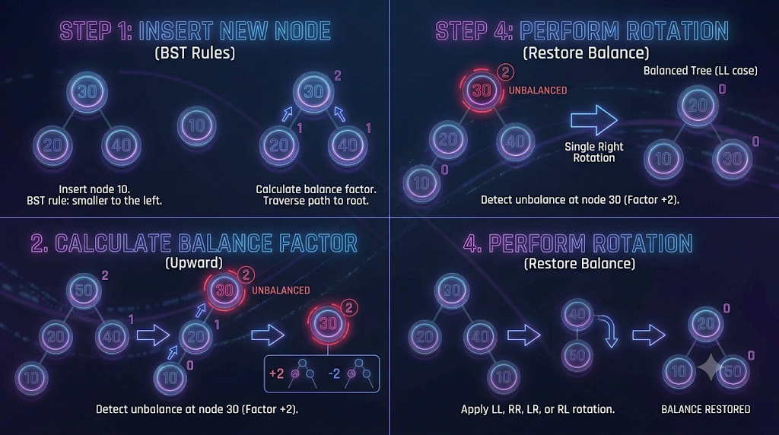
AVL Insertion
Process
Start with the normal Binary Search Tree insertion process. Insert the new key according to the BST property, then move back toward the root and check the balance factor of each node.
If the balance factor becomes less than −1 or greater than +1, the tree is unbalanced. An appropriate rotation—LL, RR, LR, or RL—is then performed to restore balance.

Slide 8

Searching in AVL
Searching in an AVL tree follows the same process as a Binary Search Tree. Start at the root and compare the target value with the current node. Move left if the target is smaller and right if it is larger.
Because AVL trees remain balanced, their height stays logarithmic. This means the search path remains short even when the number of stored elements becomes large.
The search operation takes O(log n) time in the worst case. This predictable performance makes AVL trees useful when fast and consistent searching is important.
Page 08

Slide 9
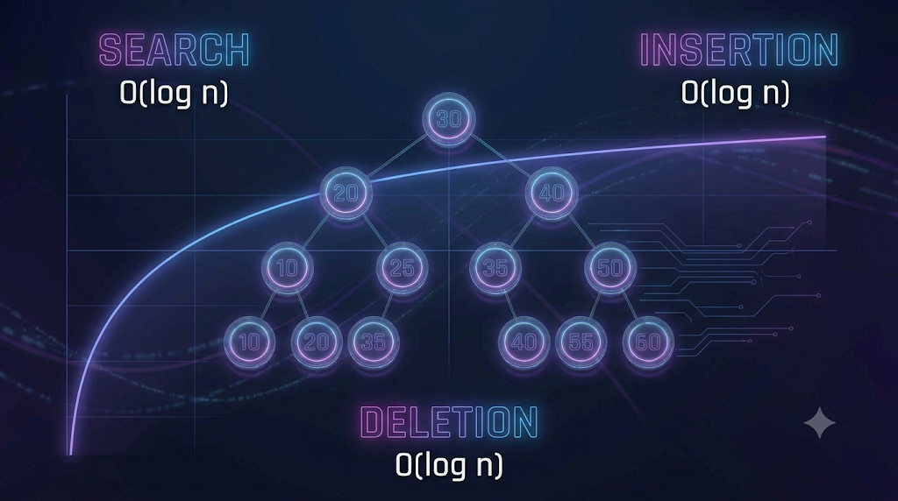
Time Complexity
of AVL Trees
AVL trees maintain a height of O(log n), providing efficient performance for major operations.
  Search: O(log n)
  Insertion: O(log n)
  Deletion: O(log n)

Slide 10
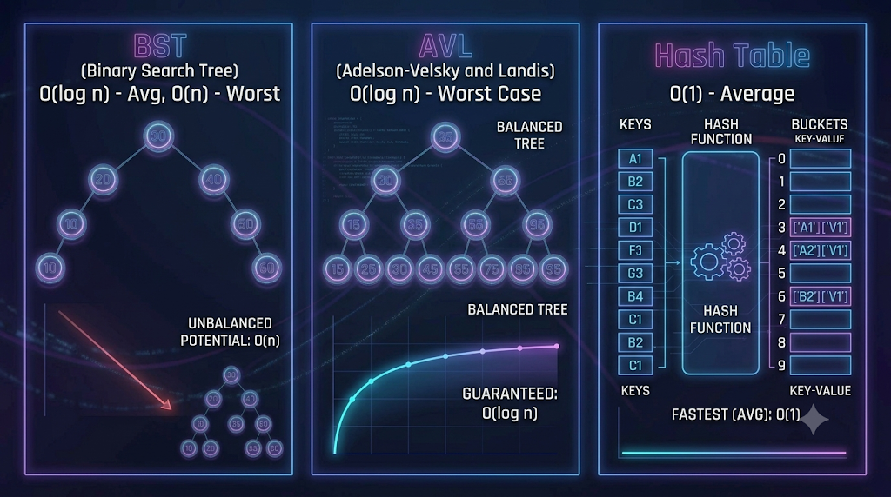
BST vs AVL vs Hash Table
  Binary Search Tree
Average Search: O(log n)
Worst Case: O(n)
  AVL Tree
Search: O(log n)
Insert/Delete: O(log n)
  Hash Table
Average Search: O(1)
Worst Case: O(n)

Slide 11
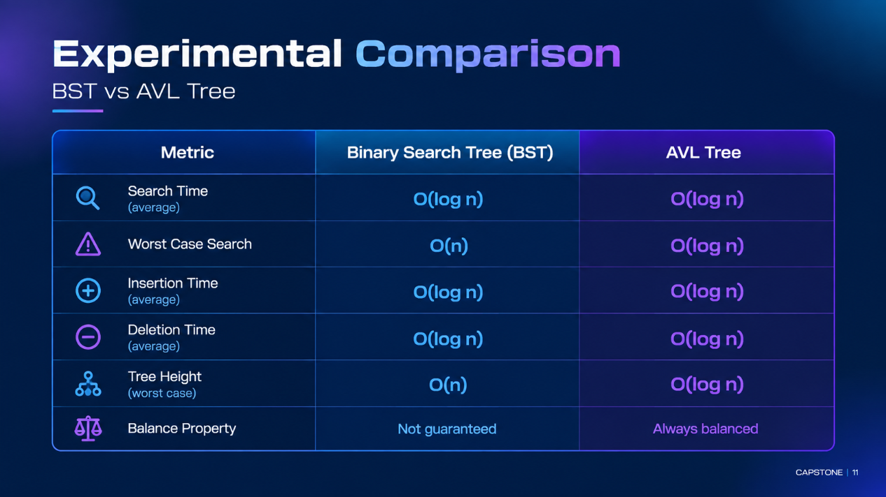

Slide 12
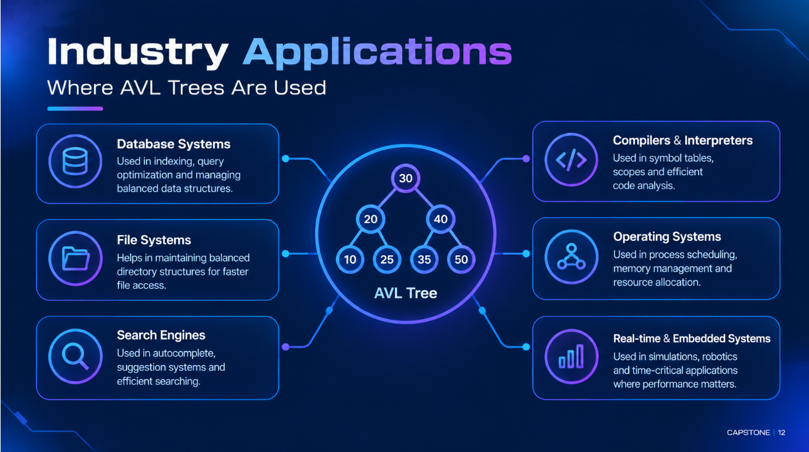

Slide 13
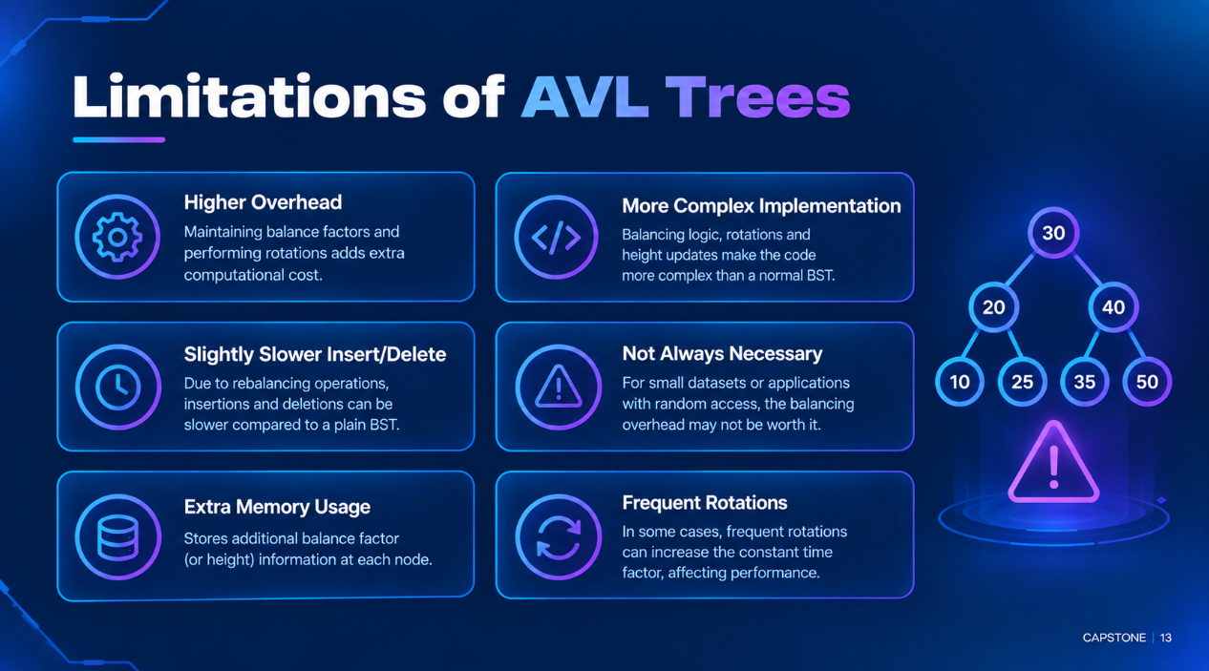

Slide 14
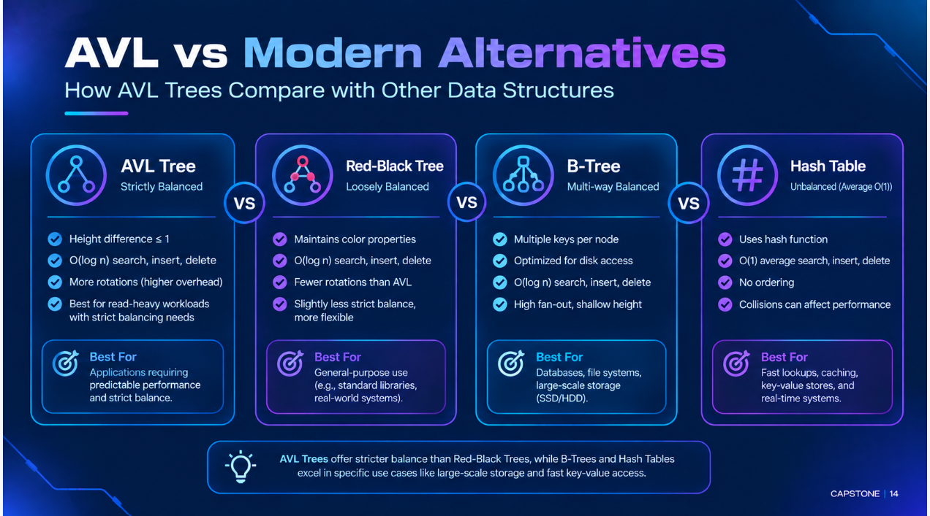

Slide 15
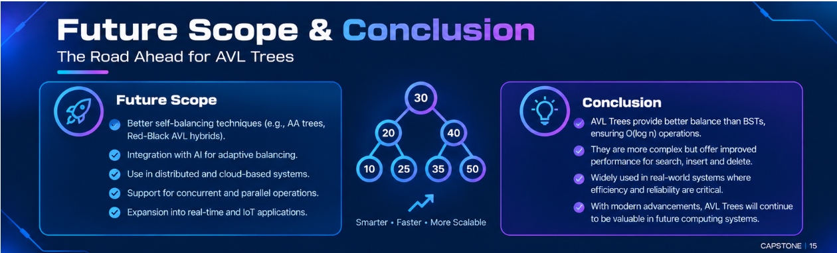

Slide 16


